Slide 1
Inflation Report August 2019
Prospects for inflation

Slide 2
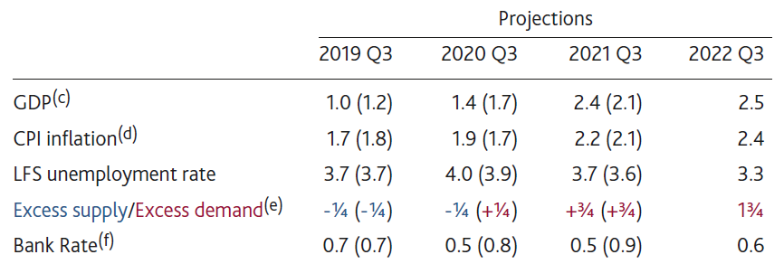
Table 5.A Forecast summary^{(a)(b)}
(a) Modal projections for GDP, CPI inflation, LFS unemployment and excess supply/excess demand. Figures in parentheses show the corresponding projections in the May 2019 Inflation Report. Projections were only available to 2022 Q2 in May.
(b) The projections have been conditioned on the Term Funding Scheme and the prevailing prices of a broad range of assets, which embody market expectations of the future stocks of purchased gilts and corporate bonds. The main assumptions are set out in the ‘Download the chart slides and data’ link at www.bankofengland.co.uk/inflation-report/2019/august-2019.
(c) Four-quarter growth in real GDP. The growth rates reported in the table exclude the backcast for GDP. Including the backcast 2019 Q3 growth is 1.0%, 2020 Q3 growth is 1.4%, 2021 Q3 growth is 2.4% and 2022 Q3 growth is 2.5%. This compares to 1.3% in 2019 Q3, 1.7% in 2020 Q3 and 2.1% in 2021 Q3 in the May 2019 Inflation Report.
(d) Four-quarter inflation rate.
(e) Per cent of potential GDP. A negative figure implies output is below potential and a positive figure that it is above.
(f) Per cent. The path for Bank Rate implied by forward market interest rates. The curves are based on overnight index swap rates.

Slide 3
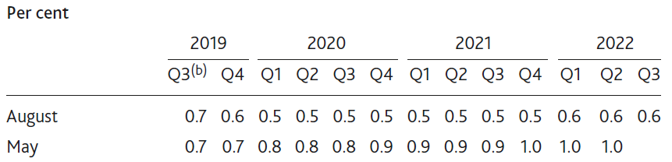
Table 5.B Conditioning path for Bank Rate implied by forward market interest rates^{(a)}
(a) The data are 15 working day averages of one‑day forward rates to 24 July 2019 and 24 April 2019 respectively. The curve is based on overnight index swap rates.
(b) August figure for 2019 Q3 is an average of realised overnight rates to 24 July 2019, and forward rates thereafter.

Slide 4
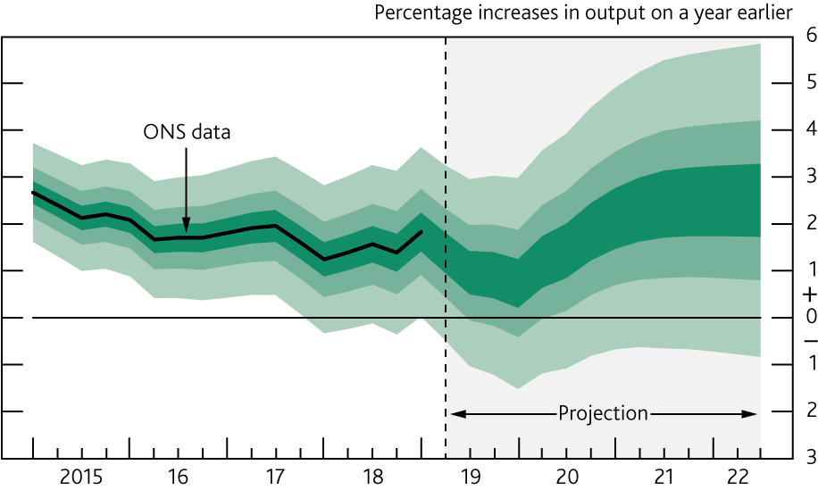
Chart 5.1 GDP projection based on market interest rate expectations, other policy measures as announced
The fan chart depicts the probability of various outcomes for GDP growth. It has been conditioned on the assumptions in Table 5.A footnote (b). To the left of the vertical dashed line, the distribution reflects uncertainty around revisions to the data over the past. To aid comparability with the official data, it does not include the backcast for expected revisions, which is available from the ‘Download the chart slides and data’ link at www.bankofengland.co.uk/inflation-report/2019/august-2019. To the right of the vertical line, the distribution reflects uncertainty over the evolution of GDP growth in the future. If economic circumstances identical to today’s were to prevail on 100 occasions, the MPC’s best collective judgement is that the mature estimate of GDP growth would lie within the darkest central band on only 30 of those occasions. The fan chart is constructed so that outturns are also expected to lie within each pair of the lighter green areas on 30 occasions. In any particular quarter of the forecast period, GDP growth is therefore expected to lie somewhere within the fan on 90 out of 100 occasions. And on the remaining 10 out of 100 occasions GDP growth can fall anywhere outside the green area of the fan chart. Over the forecast period, this has been depicted by the light grey background. See the box on page 39 of the November 2007 Inflation Report for a fuller description of the fan chart and what it represents.

Slide 5
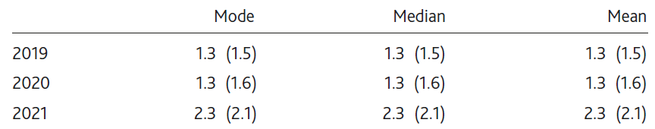
Table 5.C Annual average GDP growth rates of modal, median and mean paths^{(a)}
(a) The table shows the projections for annual average GDP growth rates of modal, median and mean projections for four‑quarter growth of real GDP implied by the fan chart. The figures in parentheses show the corresponding projections in the May 2019 Inflation Report excluding the backcast. The projections have been conditioned on the assumptions in Table 5.A footnote (b).

Slide 6
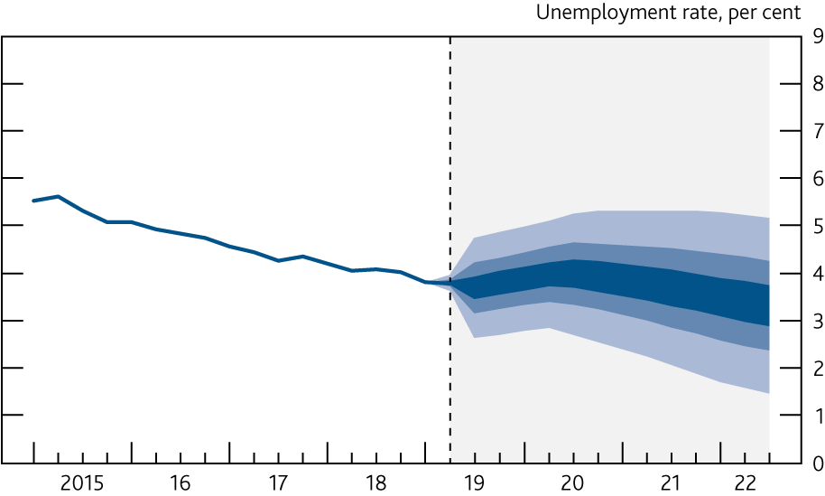
Chart 5.2 Unemployment projection based on market interest rate expectations, other policy measures as announced
The fan chart depicts the probability of various outcomes for LFS unemployment. It has been conditioned on the assumptions in Table 5.A footnote (b). The coloured bands have the same interpretation as in Chart 5.1, and portray 90% of the probability distribution. The calibration of this fan chart takes account of the likely path dependency of the economy, where, for example, it is judged that shocks to unemployment in one quarter will continue to have some effect on unemployment in successive quarters. The fan begins in 2019 Q2, a quarter earlier than the fan for CPI inflation. That is because Q2 is a staff projection for the unemployment rate, based in part on data for April and May. The unemployment rate was 3.8% in the three months to May, and is projected to be 3.8% in Q2 as a whole. A significant proportion of this distribution lies below Bank staff’s current estimate of the long-term equilibrium unemployment rate. There is therefore uncertainty about the precise calibration of this fan chart.

Slide 7
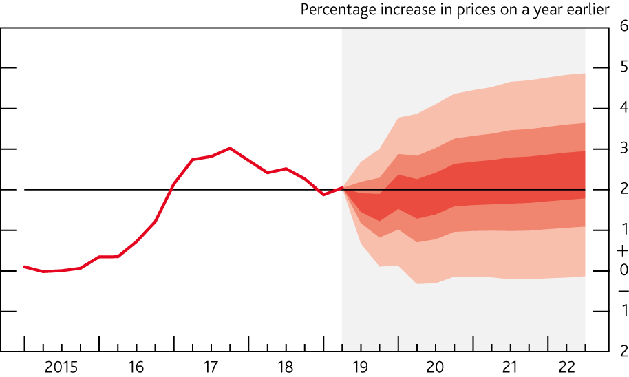
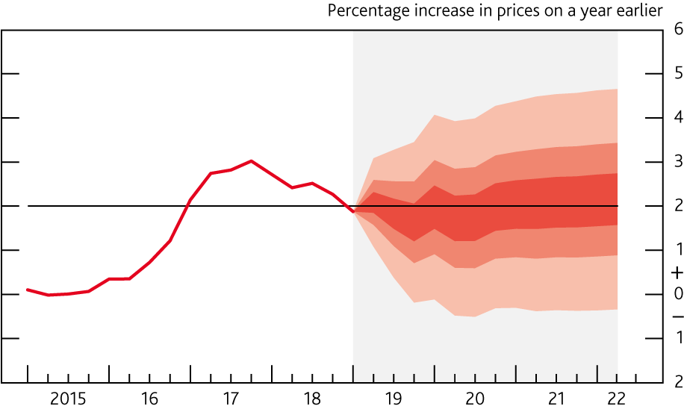
Chart 5.3 CPI inflation projection based on market interest rate expectations, other policy measures as announced
Chart 5.4 CPI inflation projection in May based on market interest rate expectations, other policy measures as announced
Charts 5.3 and 5.4 depict the probability of various outcomes for CPI inflation in the future. They have been conditioned on the assumptions in Table 5.A footnote (b). If economic circumstances identical to today’s were to prevail on 100 occasions, the MPC’s best collective judgement is that inflation in any particular quarter would lie within the darkest central band on only 30 of those occasions. The fan charts are constructed so that outturns of inflation are also expected to lie within each pair of the lighter red areas on 30 occasions. In any particular quarter of the forecast period, inflation is therefore expected to lie somewhere within the fans on 90 out of 100 occasions. And on the remaining 10 out of 100 occasions inflation can fall anywhere outside the red area of the fan chart. Over the forecast period, this has been depicted by the light grey background. See the box on pages 48–49 of the May 2002 Inflation Report for a fuller description of the fan chart and what it represents.

Slide 8
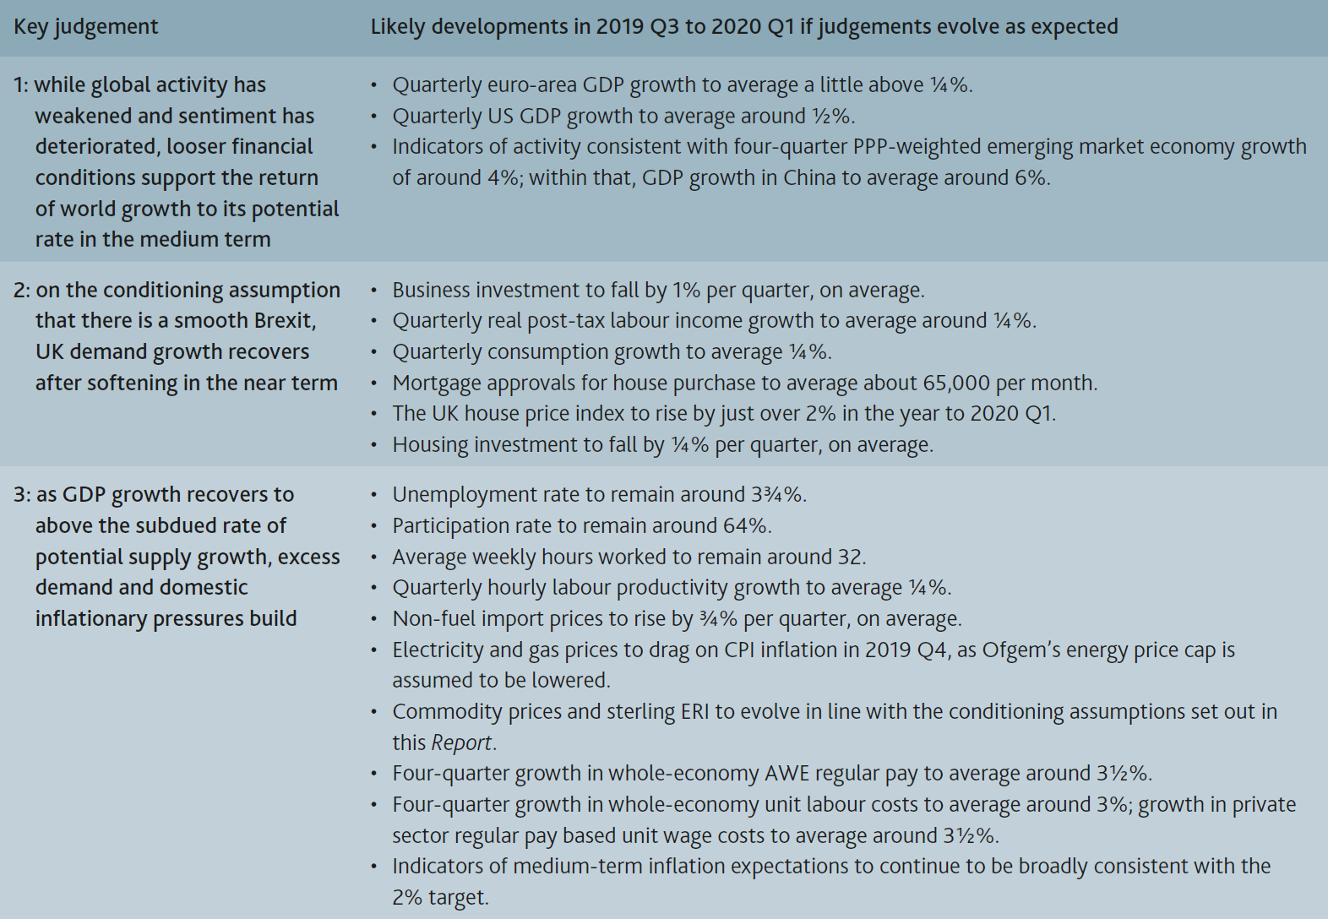
Table 5.D Monitoring risks to the Committee’s key judgements

Slide 9
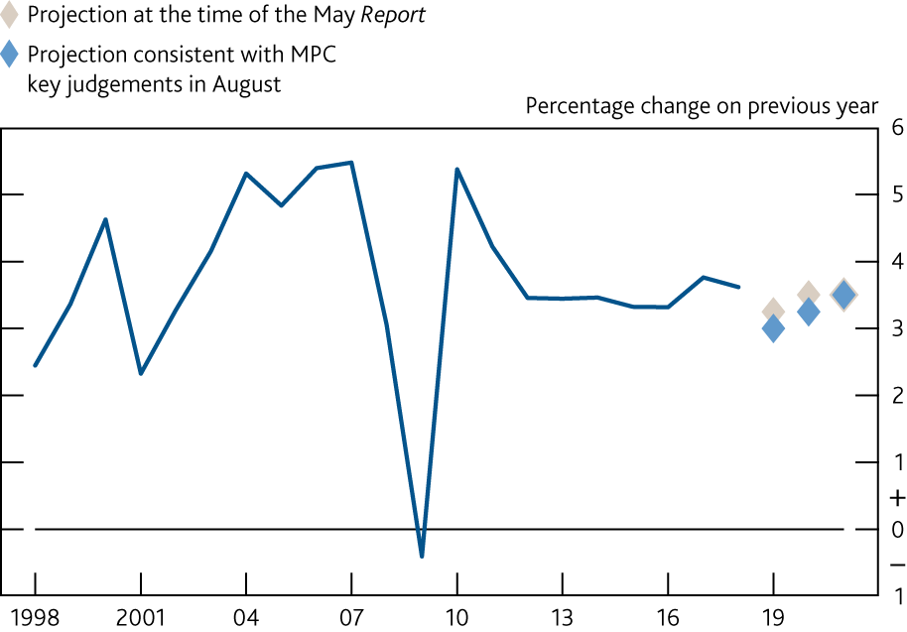
Chart 5.5 World GDP (PPP‑weighted)^{(a)}
Sources: IMF WEO and Bank calculations.
(a) Annual average growth rates. Chained-volume measure. Constructed using real GDP growth rates of 181 countries weighted according to their shares in world GDP using the IMF’s purchasing power parity (PPP) weights.

Slide 10
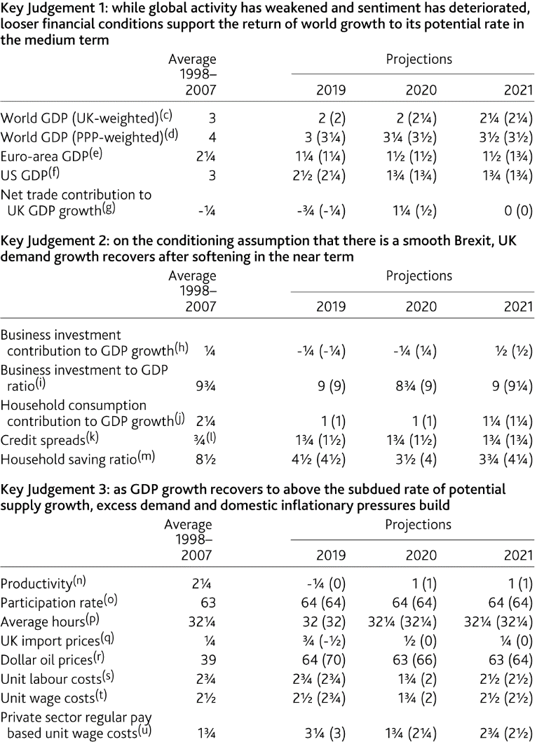
Table 5.E MPC key judgements^{(a)(b)}
Sources: Bank of England, BDRC Continental SME Finance Monitor, Bloomberg Finance L.P., British Household Panel Survey, Department for Business, Energy and Industrial Strategy, Eurostat, ICE/BoAML Global Research (used with permission), IMF World Economic Outlook (WEO), ONS, US Bureau of Economic Analysis and Bank calculations.
(a) The MPC’s projections for GDP growth, CPI inflation and unemployment (as presented in the fan charts) are underpinned by three key judgements. The mapping from the key judgements to individual variables is not precise, but the profiles in the table should be viewed as broadly consistent with the MPC’s key judgements.
(b) Figures show annual average growth rates unless otherwise stated. Figures in parentheses show the corresponding projections in the May 2019 Inflation Report.
(c) Chained-volume measure. Constructed using real GDP growth rates of 180 countries weighted according to their shares in UK exports.
(d) Chained-volume measure. Constructed using real GDP growth rates of 181 countries weighted according to their shares in world GDP using the IMF’s purchasing power parity (PPP) weights.
(e) Chained-volume measure. Forecast was finalised before the release of the preliminary flash estimate of euro-area GDP for Q2, so that has not been incorporated.
(f) Chained-volume measure. Forecast was finalised before the release of the advance estimate of US GDP for Q2, so that has not been incorporated.
(g) Chained-volume measure. Exports less imports.
(h) Chained-volume measure.
(i) Chained-volume business investment as a percentage of GDP.
(j) Chained-volume measure. Includes non-profit institutions serving households.
(k) Level in Q4. Percentage point spread over reference rates. Based on a weighted average of household and corporate loan and deposit spreads over appropriate risk-free rates. Indexed to equal zero in 2007 Q3.
(l) Based on the weighted average of spreads for households and large companies over 2003 and 2004 relative to the level in 2007 Q3. Data used to construct the SME spread are not available for that period. The period is chosen as broadly representative of one where spreads were neither unusually tight nor unusually loose.
(m) Annual average. Percentage of total available household resources.
(n) GDP per hour worked.
(o) Level in Q4. Percentage of the 16+ population.
(p) Level in Q4. Average weekly hours worked, in main job and second job.
(q) Four-quarter inflation rate in Q4 excluding fuel and the impact of MTIC fraud.
(r) Average level in Q4. Dollars per barrel. Projection based on monthly Brent futures prices for the first two quarters of the forecast period, then held flat.
(s) Four-quarter growth in unit labour costs in Q4. Whole-economy total labour costs divided by GDP at constant prices, based on the mode of the MPC’s GDP backcast. Total labour costs comprise compensation of employees and the labour share multiplied by mixed income.
(t) Four-quarter growth in whole-economy unit wage costs in Q4. Whole-economy wage costs divided by GDP at constant prices, based on the mode of the MPC’s GDP backcast. Total wage costs are wages and salaries excluding non-wage costs and the labour share multiplied by mixed income.
(u) Four-quarter growth in private sector regular pay based unit wage costs in Q4. Private sector wage costs divided by private sector output at constant prices, based on the mode of the MPC’s GDP backcast. Private sector wage costs are average weekly earnings (excluding bonuses) multiplied by private sector employment.

Slide 11
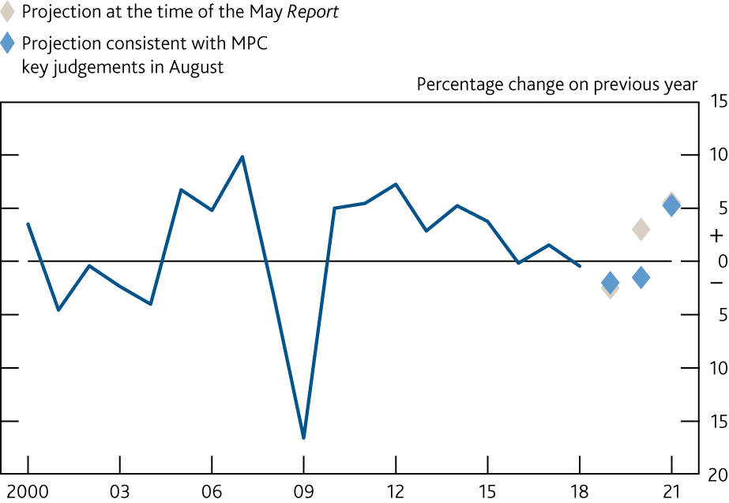
Chart 5.6 Business investment^{(a)}
Sources: ONS and Bank calculations.
(a) Annual average growth rates. Chained-volume measure. Business investment data based on GAN8. Investment data take account of the transfer of nuclear reactors from the public corporation sector to central government in 2005 Q2.

Slide 12
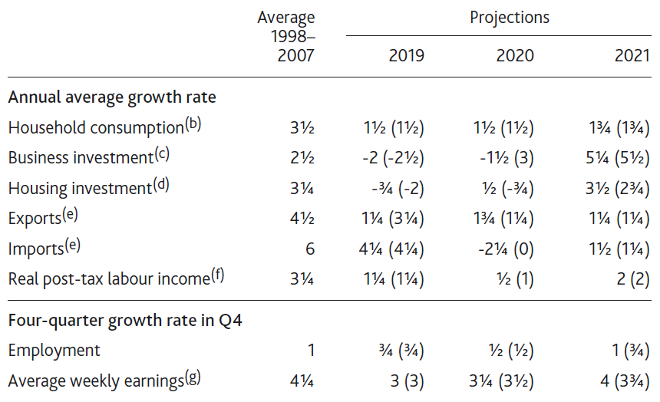
Table 5.F Indicative projections consistent with the MPC’s modal projections^{(a)}
(a) These projections are produced by Bank staff for the MPC to be consistent with the MPC’s modal projections for GDP growth, CPI inflation and unemployment. Figures in parentheses show the corresponding projections in the May 2019 Inflation Report.
(b) Chained-volume measure. Includes non-profit institutions serving households.
(c) Chained-volume measure.
(d) Chained-volume measure. Whole-economy measure. Includes new dwellings, improvements and spending on services associated with the sale and purchase of property.
(e) Chained-volume measure. The historical data exclude the impact of missing trader intra-community (MTIC) fraud.
(f) Wages and salaries plus mixed income and general government benefits less income taxes and employees’ National Insurance contributions, deflated by the consumer expenditure deflator.
(g) Whole-economy total pay.

Slide 13
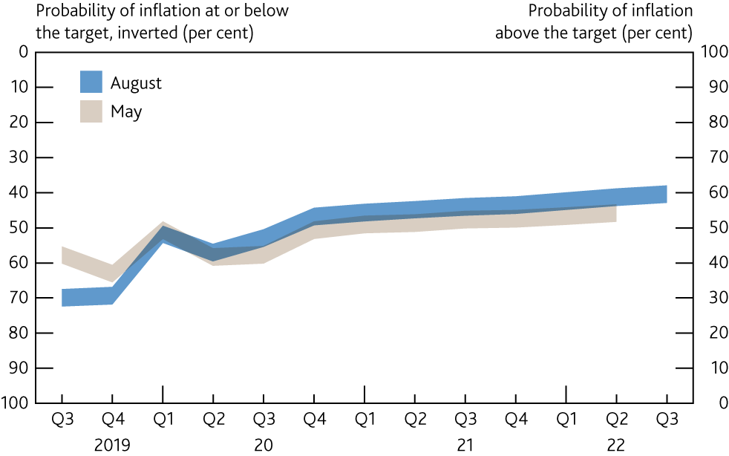
Chart 5.7 Inflation probabilities relative to the target
The August and May swathes in this chart are derived from the same distributions as Charts 5.3 and 5.4 respectively. They indicate the assessed probability of inflation relative to the target in each quarter of the forecast period. The 5 percentage points width of the swathes reflects the fact that there is uncertainty about the precise probability in any given quarter, but they should not be interpreted as confidence intervals.

Slide 14
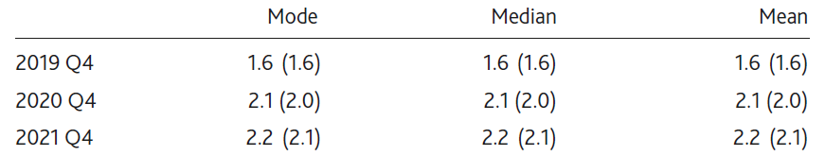
Table 5.G Q4 CPI inflation
The table shows projections for Q4 four‑quarter CPI inflation. The figures in parentheses show the corresponding projections in the May 2019 Inflation Report. The projections have been conditioned on the assumptions in Table 5.A footnote (b).

Slide 15
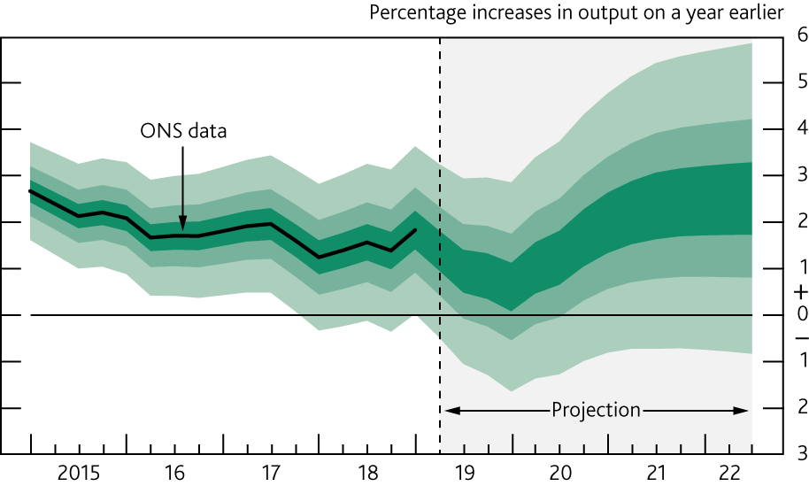
Chart 5.8 GDP projection based on constant nominal interest rates at 0.75%, other policy measures as announced
See footnote to Chart 5.1.

Slide 16
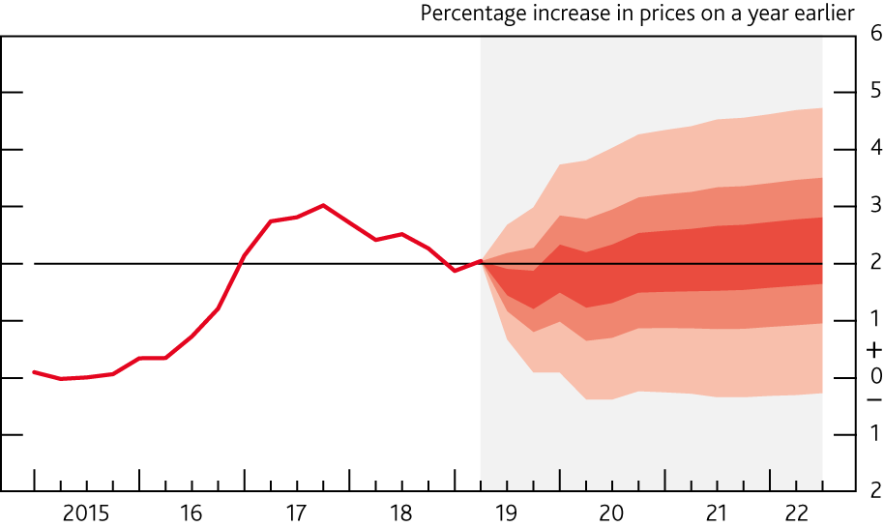
Chart 5.9 CPI inflation projection based on constant nominal interest rates at 0.75%, other policy measures as announced
See footnote to Chart 5.3.

Slide 17
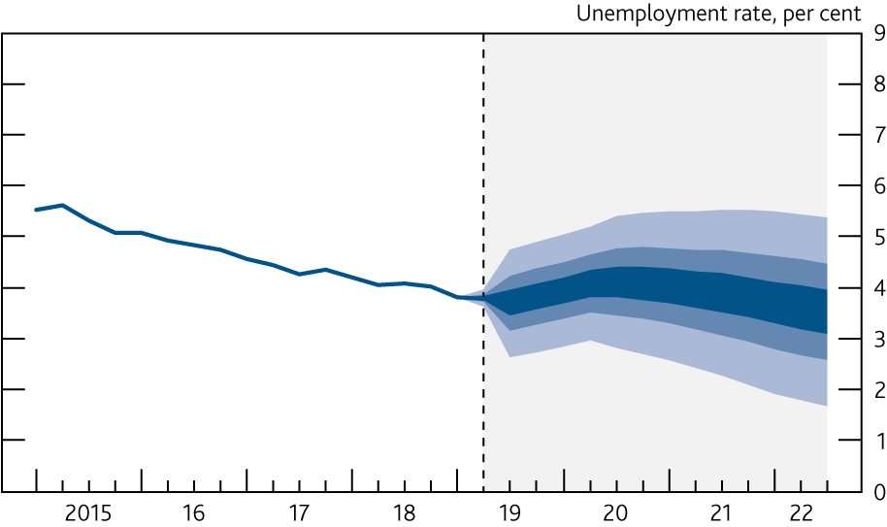
Chart 5.10 Unemployment rate projection based on constant nominal interest rates at 0.75%, other policy measures as announced
See footnote to Chart 5.2.

Slide 18
Box 6
The sensitivities of the MPC’s projections to financial market expectations about the Brexit outcome

Slide 19
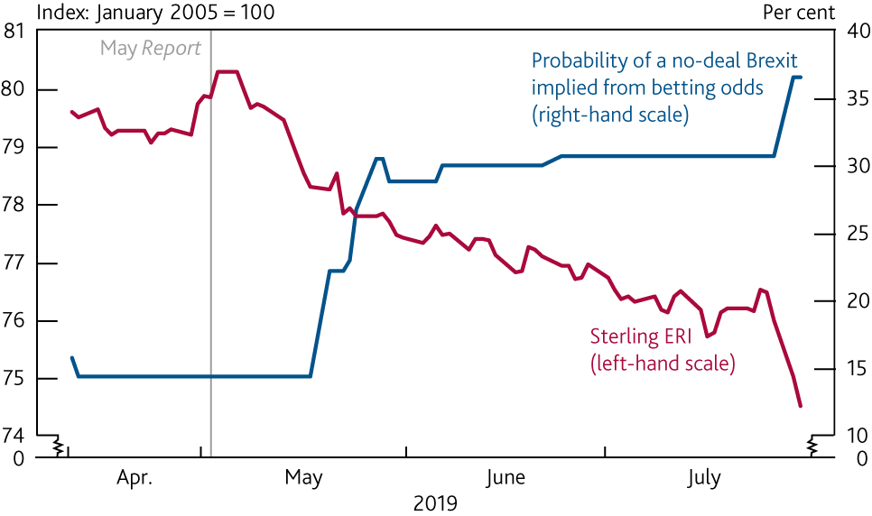
Chart A Sterling has depreciated as the perceived probability of a no-deal Brexit has risen
Sterling ERI and perceived probability of a no-deal Brexit^{(a)}
Sources: Bank of England, Betfair and Bank calculations.
(a) The implied probability is calculated from Betfair betting odds on leaving the EU in 2019 without a Withdrawal Agreement in place. Data from 11 April to 30 July 2019.

Slide 20
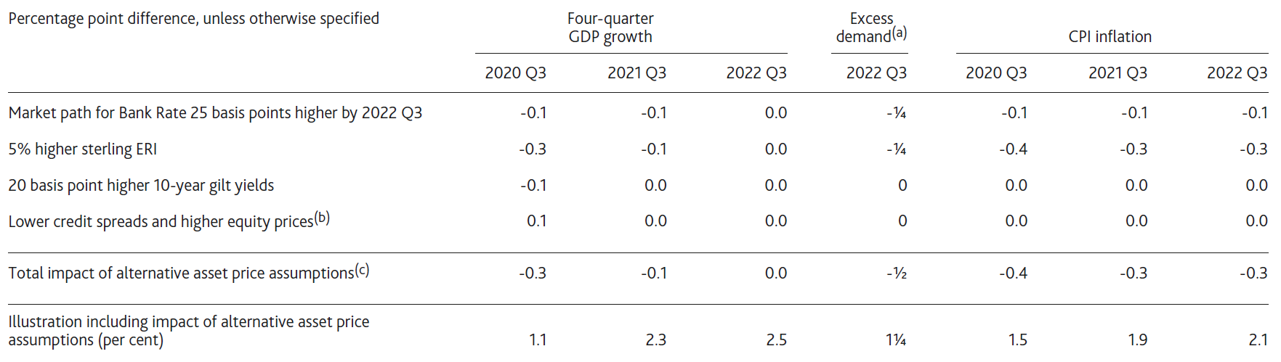
Table 1 The sensitivities of the MPC’s GDP growth, excess demand and inflation projections to given stylised changes in asset prices, holding everything else constant
(a) Per cent of potential GDP.
(b) Includes the impact of a 10 basis point fall in bank funding spreads, a 10 basis point fall in UK investment-grade non-financial corporate bond spreads, a 40 basis point fall in UK high-yield non-financial corporate bond spreads and a 7½% rise in UK-focused equity prices.
(c) This row adjusts for the estimated endogenous response of other asset prices — particularly the exchange rate — to changes in the market path for Bank Rate. As a result, the component rows may not sum to the total impact.

Slide 21
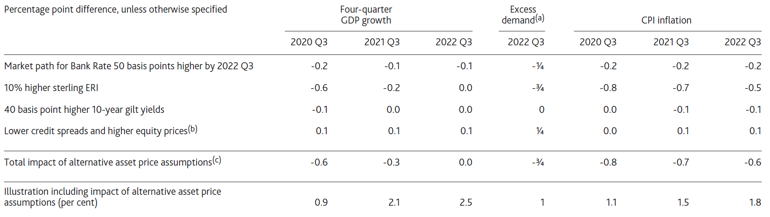
Table 2 The sensitivities of the MPC’s GDP growth, excess demand and inflation projections to given stylised changes in asset prices, holding everything else constant
(a) Per cent of potential GDP.
(b) Includes the impact of a 20 basis point fall in bank funding spreads, a 20 basis point fall in UK investment-grade non-financial corporate bond spreads, an 80 basis point fall in UK high-yield non-financial corporate bond spreads and a 15% rise in UK-focused equity prices.
(c) This row adjusts for the estimated endogenous response of other asset prices — particularly the exchange rate — to changes in the market path for Bank Rate. As a result, the component rows may not sum to the total impact.

Slide 22
Box 7
Other forecasters’ expectations

Slide 23
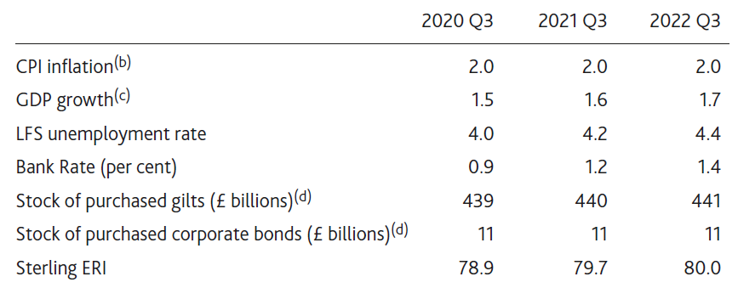
Table 1 Averages of other forecasters’ central projections^{(a)}
Source: Projections of outside forecasters as of 19 July 2019.
(a) For 2020 Q3, there were 21 forecasts for CPI inflation, GDP growth and Bank Rate, 19 for the unemployment rate, 14 for the stock of gilt purchases, 10 for the stock of corporate bond purchases and 9 for sterling ERI. For 2021 Q3, there were 18 forecasts for CPI inflation and GDP growth, 17 for the unemployment rate and Bank Rate, 11 for the stock of gilt purchases, 7 for the stock of corporate bond purchases and 9 for sterling ERI. For 2022 Q3, there were 16 forecasts for CPI inflation, 15 for GDP growth, 14 for the unemployment rate, 15 for Bank Rate, 9 for the stock of gilt purchases, 5 for the stock of corporate bond purchases and 9 for sterling ERI.
(b) Twelve-month rate.
(c) Four-quarter percentage change.
(d) Original purchase value. Purchased via the creation of central bank reserves.

Slide 24
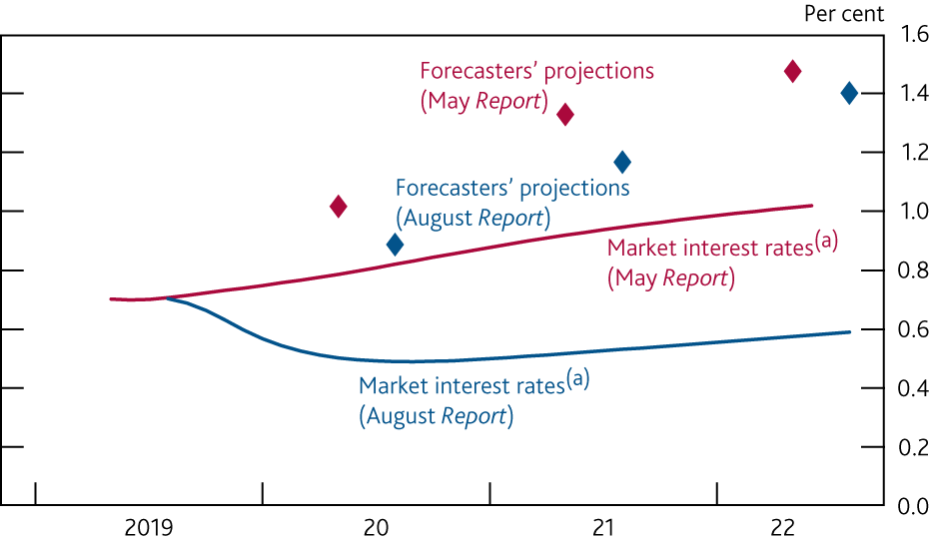
Chart A Forecasters’ projections of Bank Rate imply a steeper path than market interest rates
Market interest rates and averages of forecasters’ central projections for Bank Rate
Sources: Bloomberg Finance L.P., projections of outside forecasters provided for Inflation Reports in May 2019 and August 2019 and Bank calculations.
(a) Estimated using instantaneous forward overnight index swap rates in the 15 working days to 24 April and 24 July 2019 respectively.

Slide 25
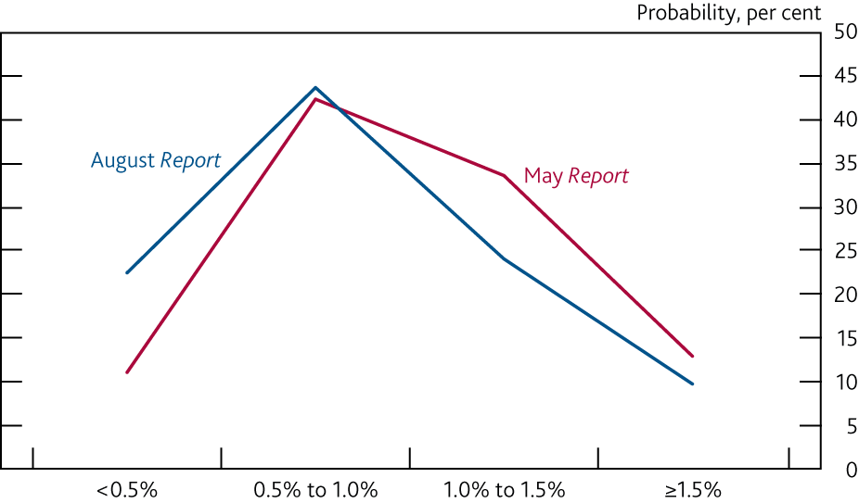
Chart B Forecasters placed a higher probability on lower levels of Bank Rate than three months ago
Average of forecasters’ probability distributions for Bank Rate in one year’s time^{(a)}
Sources: Projections of outside forecasters provided for Inflation Reports in May and August 2019.
(a) Projections on the boundary of these ranges are included in the upper range, for example a projection of Bank Rate being 1.0% is in the 1.0% to 1.5% range.

